Slide 1
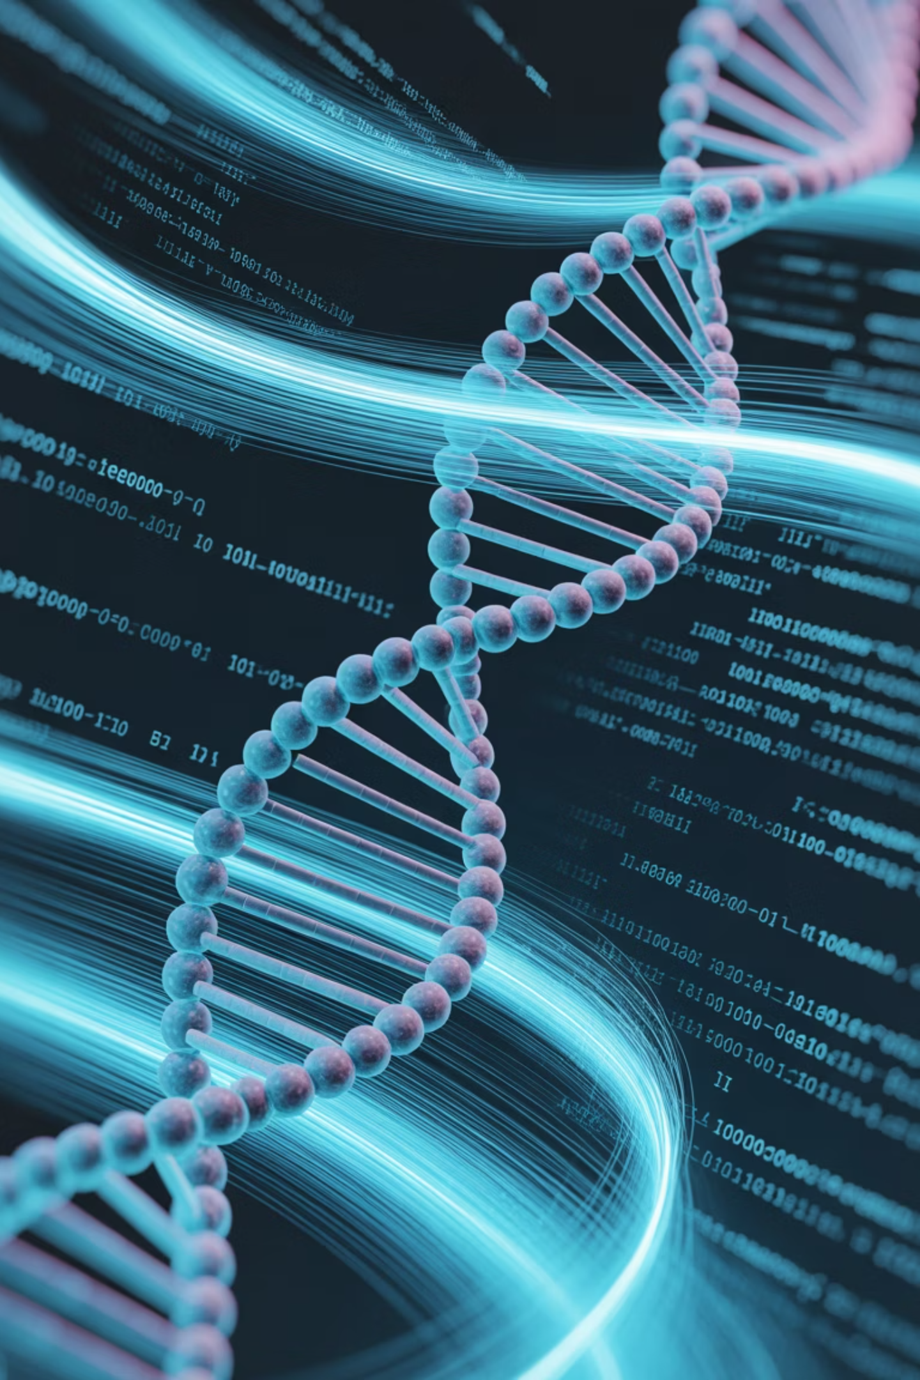
Introduction to Bioinformatics
Bioinformatics is an interdisciplinary field that combines:
Biology
Computer Science
Mathematics
Information Technology
To store, analyze, and interpret biological data such as DNA, RNA, and protein sequences.
It helps scientists understand how biological systems work by using computational tools and software.

Slide 2
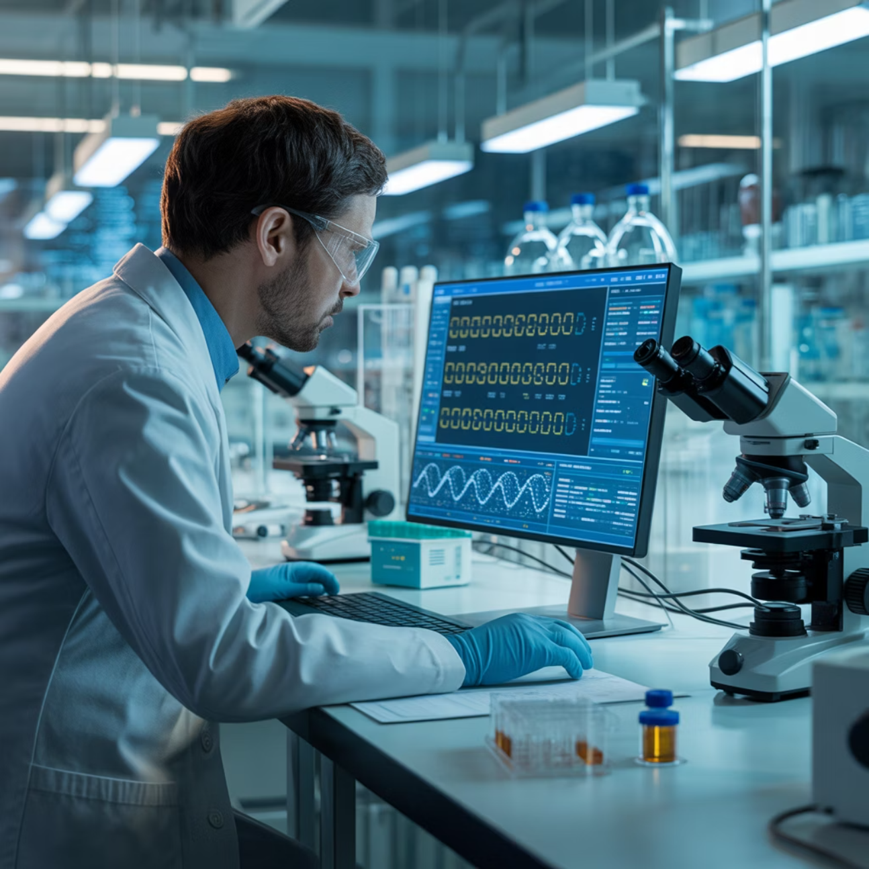
What is Bioinformatics?
Definition
"The application of computational methods to store, retrieve, analyze, and interpret biological data—particularly DNA, RNA, and protein sequences."
This powerful field bridges experimental biology and computational science, enabling researchers to process massive datasets and uncover patterns that would be impossible to detect manually.

Slide 3





Core Objectives
Store & Organize
Analyze & Interpret
Predict
Manage large biological datasets including DNA, RNA, and protein sequences
Find relationships and patterns in biological data
Forecast structure and function of biomolecules
Support Research
Integrate
Enable drug discovery, genomics, and personalized medicine
Combine biological information from multiple sources

Slide 4
Major Areas of Bioinformatics
Genomics
Proteomics
Transcriptomics
Metabolomics
Study of complete genomes and gene sequences
Study of proteins—their structures and functions
Study of RNA transcripts produced by the genome
Study of small molecules (metabolites) in cells
Systems Biology
Modeling and simulation of biological systems

Slide 5

Key Components
Databases & Tools
A. Databases
B. Tools and Software
Repositories that store biological data for easy access and retrieval.
Used to analyze and compare biological sequences.
Examples: GenBank, EMBL, DDBJ, PDB, UniProt
Examples: BLAST, FASTA, Clustal Omega, PyMOL, MEGA
GenBank (NCBI, USA) – Nucleotide sequences
EMBL (Europe) – European Molecular Biology Laboratory database
DDBJ (Japan) – DNA Data Bank of Japan
PDB – Protein Data Bank (3D protein structures)

Slide 6
Applications of Bioinformatics
Gene Identification
Protein Modeling
Gene identification and genome annotation
Protein modeling and structure prediction
Evolutionary Studies
Drug Discovery
Phylogenetic analysis and evolutionary relationships
Drug design and discovery processes
Personalized Medicine
Agricultural Biotech
Tailored treatments based on genetic profiles
Crop improvement and agricultural biotechnology

Slide 7

Bioinformatics Databases
Organized Collections of Biological Data
Bioinformatics databases are organized collections of biological data (DNA, RNA, proteins, pathways, etc.) stored electronically for easy access, search, and analysis.
They are essential because modern biology generates huge volumes of data that must be stored, processed, and shared systematically.

Slide 8




Primary Databases
Raw Experimental Data
Primary databases contain raw experimental data submitted directly by researchers. Data is original and unprocessed.
GenBank (NCBI, USA)
EMBL (Europe)
Nucleotide sequences
European Molecular Biology Laboratory database
DDBJ (Japan)
PDB
DNA Data Bank of Japan
Protein Data Bank (3D protein structures)
Key Uses
Sequence comparison and gene identification
Structural and functional modeling
Base data source for other databases

Slide 9

Secondary Databases
Curated & Analyzed Data
Secondary databases contain interpreted, curated, or analyzed data derived from primary sources. They include annotations, motifs, and functional predictions.
Examples:
Pfam – Protein families and domains
PROSITE – Protein patterns and motifs
InterPro – Integrated protein family information
Swiss-Prot / UniProtKB – Curated protein data with functional info
Key Uses
Predicting protein function and structure
Identifying conserved regions or motifs
Supporting evolutionary and functional studies

Slide 10
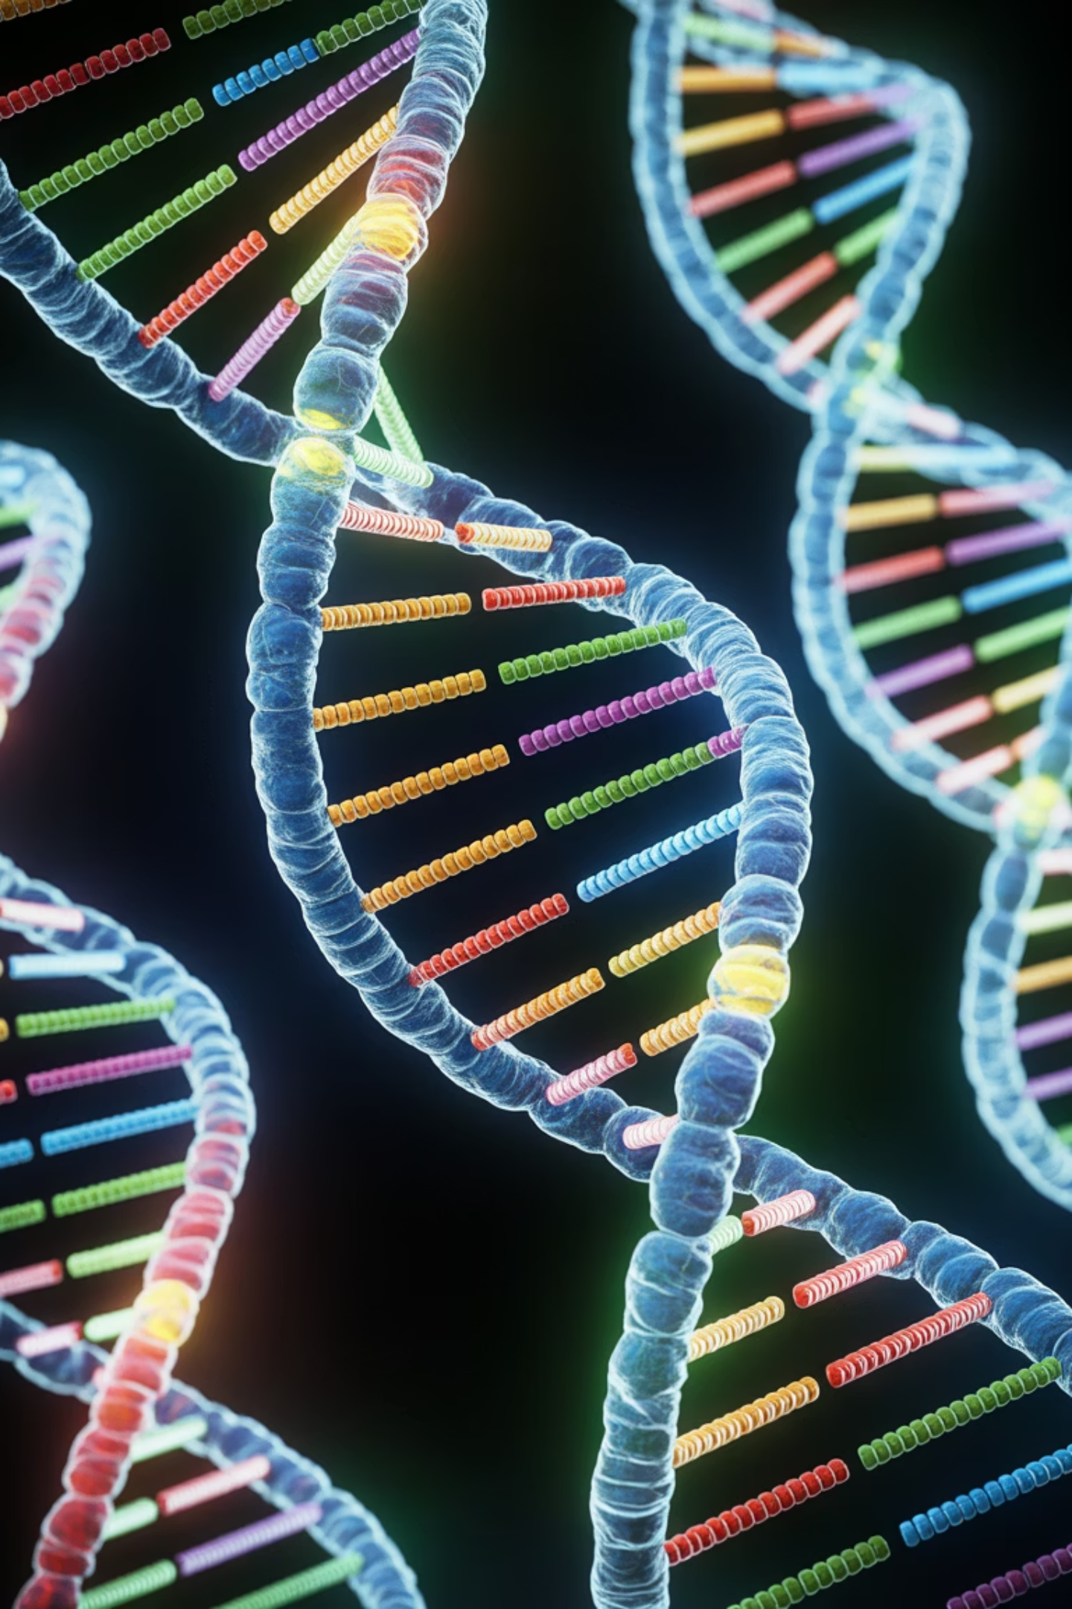
Sequence Alignment Tools
FASTA and BLAST
When a new DNA, RNA, or protein sequence is discovered, researchers use sequence alignment tools to identify similar sequences (homology), predict function or evolutionary relationships, and locate conserved regions or mutations.
Two widely used alignment tools are FASTA and BLAST.

Slide 11
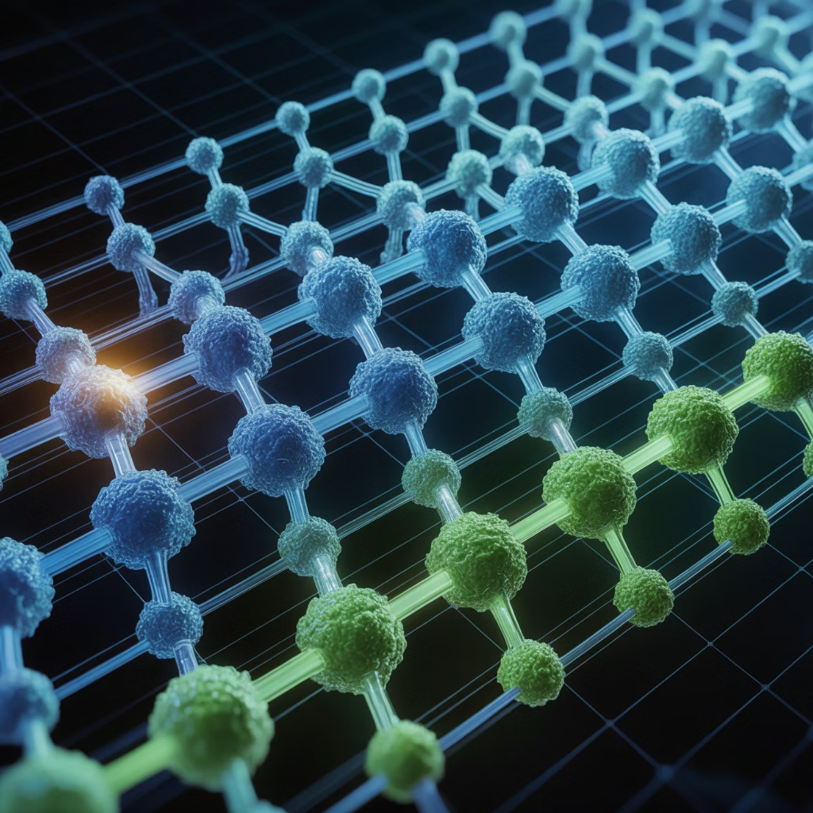
FASTA: Fast Alignment Tool
Overview
How FASTA Works
Full Form: FAST-All (from file extension .fasta)
01
Word Search
Developed by: David J. Lipman & William R. Pearson,
1985
Finds short matching sequence fragments
Purpose: To find regions of similarity between a query sequence and sequences in a database.
02
Scoring
Assigns scores to matches based on similarity
03
Extension
Extends matches to form longer alignments
04
Optimization
Refines the best alignments

Slide 12
FASTA: Uses & Evaluation
Uses
Advantages
Limitations
Detect homologous (similar) sequences
Accurate for small datasets
Slower with very large databases
Works for both DNA and protein sequences
Predict gene or protein functions
Perform pairwise alignments

Slide 13
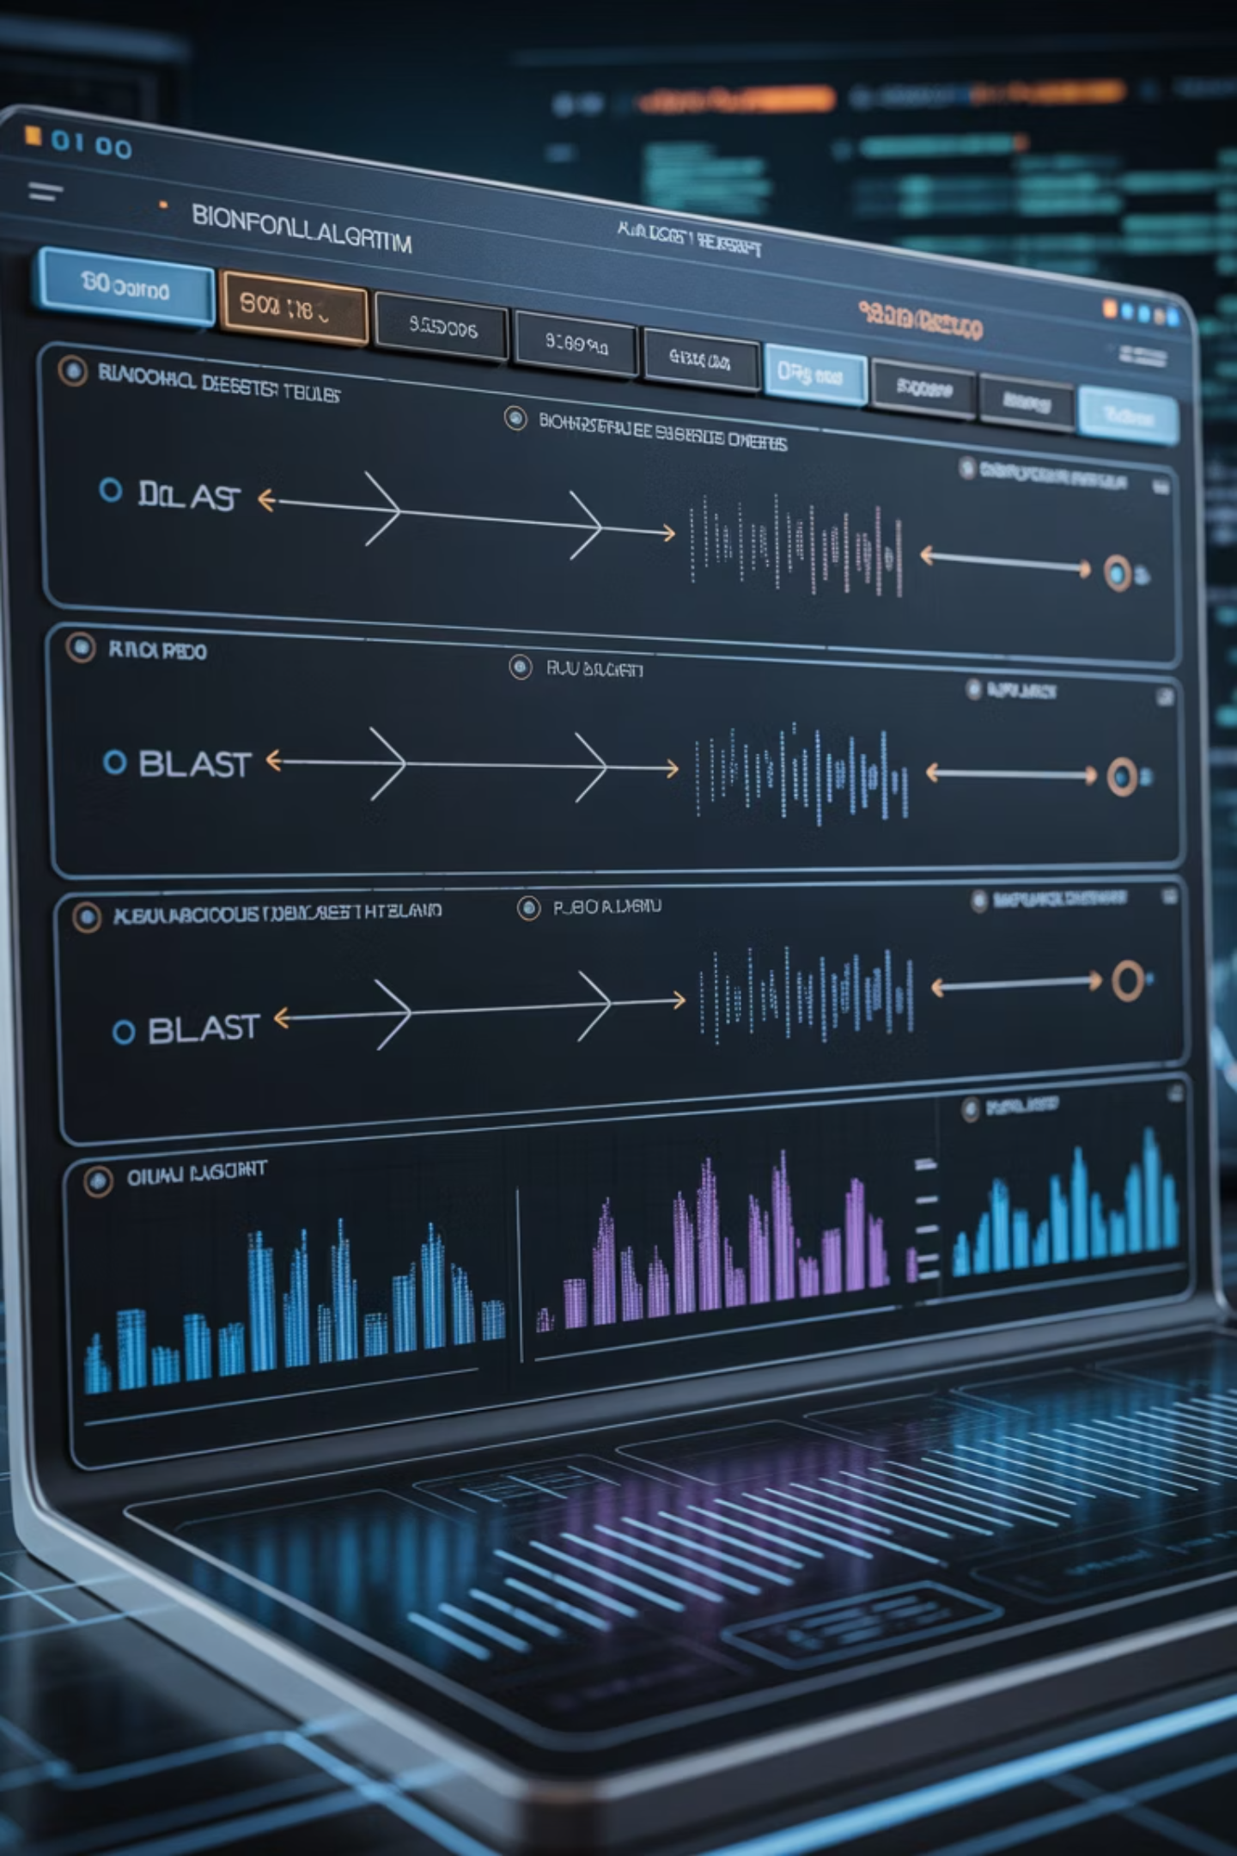



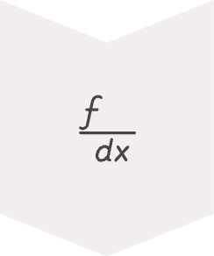
BLAST: Basic Local Alignment Search Tool
Developed by: Stephen Altschul and colleagues, NCBI, 1990
Purpose: To quickly find local regions of similarity between biological sequences.
Word Matching
Splits query into short words (3 for proteins, 11 for DNA)
Database Search
Finds potential matches for these words
Extension
Extends matches to form high-scoring alignments
Scoring & Statistics
Provides alignment score and E-value

Slide 14
Types of BLAST
Type
Function
blastn
Nucleotide vs. nucleotide database
blastp
Protein vs. protein database
blastx
Translated nucleotide vs. protein database
tblastn
Protein vs. translated nucleotide database
tblastx
Translated query vs. translated database

Slide 15
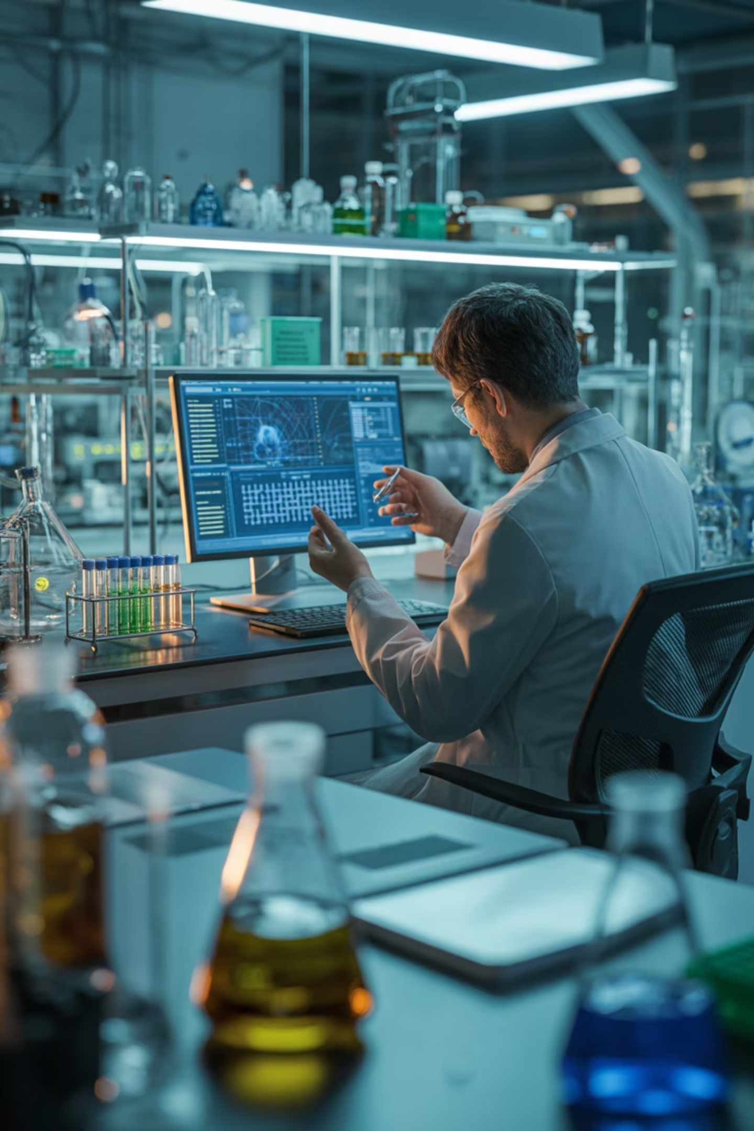
BLAST: Applications & Strengths
Uses of BLAST
Advantages
Identify similar genes or proteins
Very fast and efficient for large databases
Study evolutionary relationships
Annotate genomes
Provides statistical scores (E-values)
Find conserved regions or mutations
Integrated in NCBI and other platforms
Support drug discovery and functional genomics
Limitations
May miss weak similarities
Focuses on local (not full-length) alignments

Slide 16
FASTA vs. BLAST Comparison
Feature
FASTA
BLAST
Full Form
FAST-All
Basic Local Alignment Search Tool
Developed by
Lipman & Pearson (1985)
Altschul et al. (1990)
Type of Alignment
Global or Local
Local
Speed
Slower
Faster
Accuracy
High for small datasets
High for large datasets
Output
Alignment score only
Score + E-value + Statistics
Best for
Small datasets
Large database searches

Slide 17
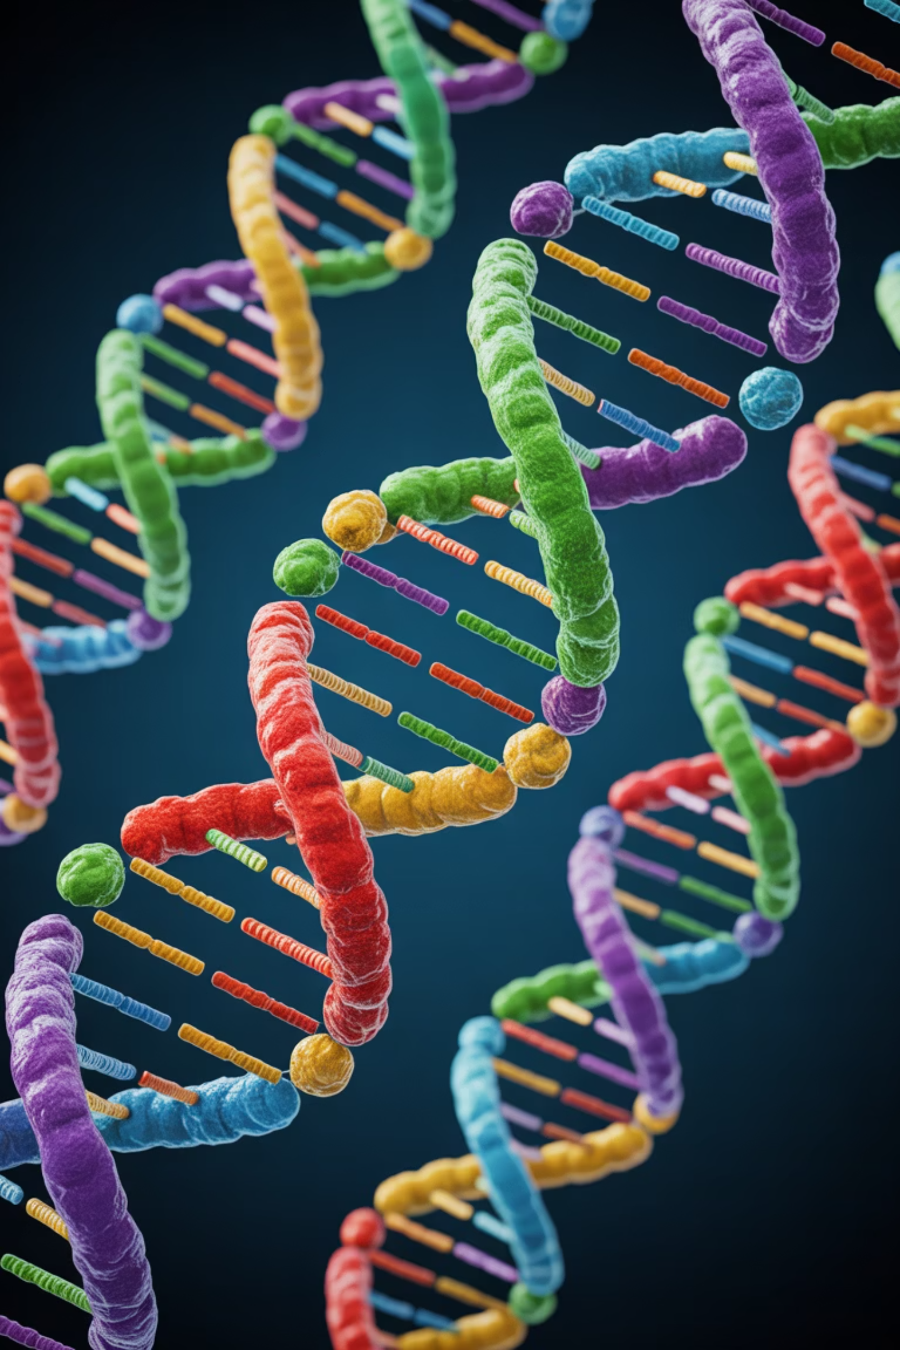



The Power of Sequence Alignment
Identify Homology
Discover evolutionary relationships between sequences and trace the history of genes across species
Predict Function
Infer the function of unknown sequences by comparing them to well-characterized genes or proteins
Find Conserved Regions
Locate critical functional domains and regulatory elements that are preserved across evolution

Slide 18










Integration: From Data to Discovery
Alignment Tools
Databases
Compare and analyze sequences (FASTA, BLAST)
Store biological sequences and structures
Analysis
Interpret results and identify patterns
New Data
Research
Submit discoveries back to databases
Apply findings to medicine, agriculture, and biotechnology

Slide 19
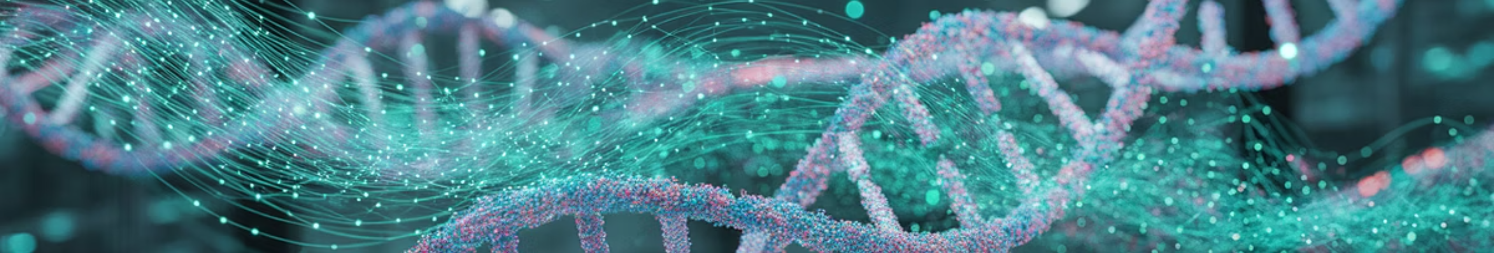
Summary: The Bioinformatics Revolution
Interdisciplinary Foundation
Essential Infrastructure
Bioinformatics integrates biology and computation to analyze biological data at unprecedented scales
Databases store and organize nucleotide, protein, and structural information for global access
Powerful Tools
Transformative Impact
FASTA and BLAST are core sequence alignment tools that enable rapid comparison and analysis
Together, these tools help scientists compare, annotate, and interpret biological sequences, leading to major advances in medicine, biotechnology, and genomics

